Slide 1
HW 6
Antennas in the Wilderness
Youssef Samwel

Slide 2
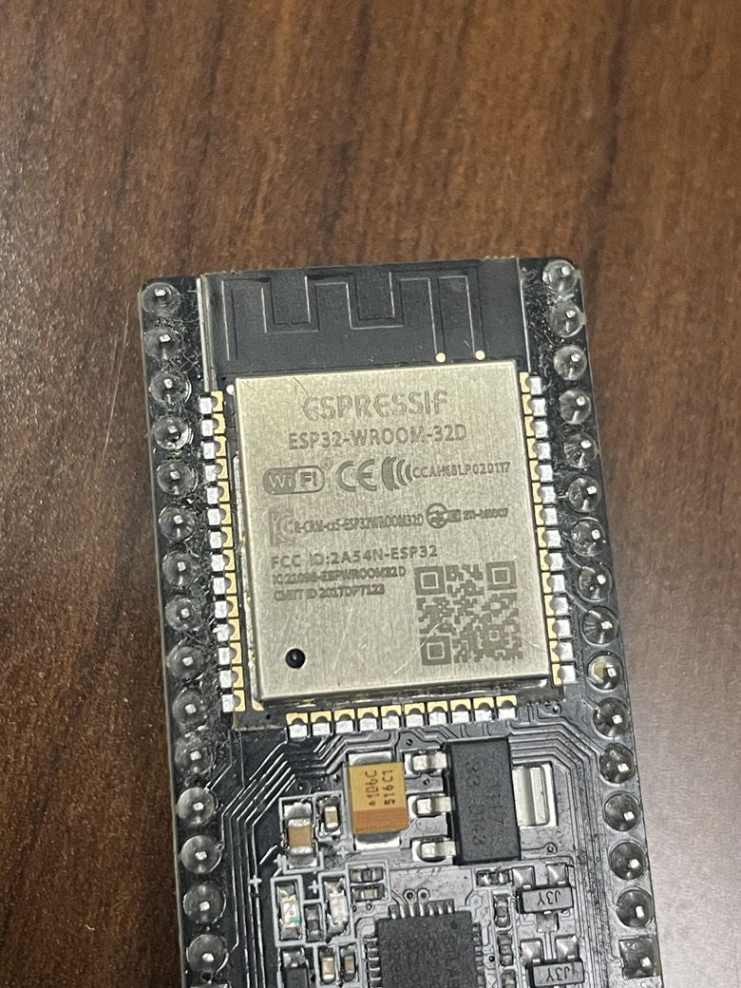
F-Inverted Antenna
Location: My Bedroom
Estimated Gain and Freq:
2 dBi Gain at 2.4 GHz
Use: IoT devices, Sensor data collection, Router, Web Server, and General Automation.
I used this to make digital oscilloscope with the ADC and transmitting the results to my PC over HTTP/IP.

Slide 3
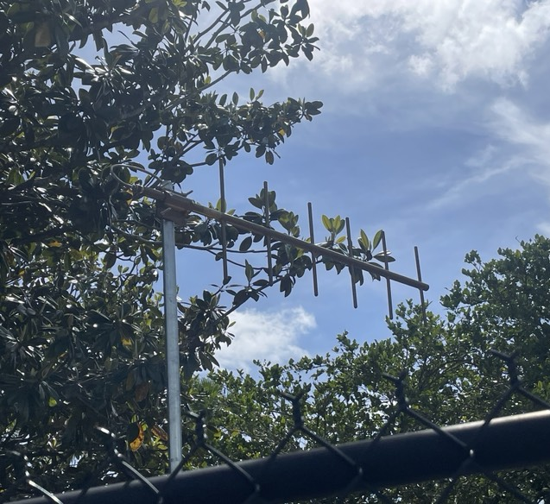
Panel Antennas
Location: Nieborhood Park
Estimated Gain and Freq:
10-13 dBi Gain between 700-1400 MHz
Use: This is a very common Yagi antenna it is used everywhere for utilities. This is easier than routing ethernet cable to each site.

Slide 4
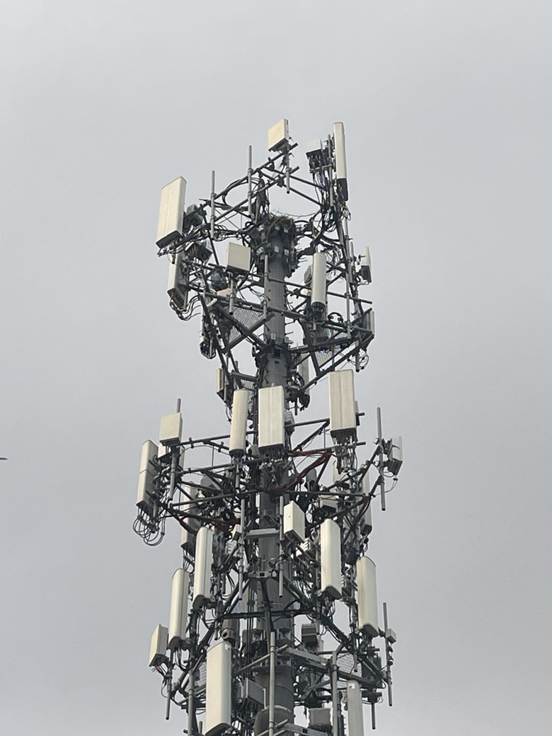
Panel Antenna
Location: 1800 Ten Point Lane (E018) Orlando FL 32837
Estimated Gain and Freq:
10-13 dBi @ 600 – 850 MHz
Use: This is used for cell tower communication. There are dipole antenna array and Panel antenna array.

Slide 5
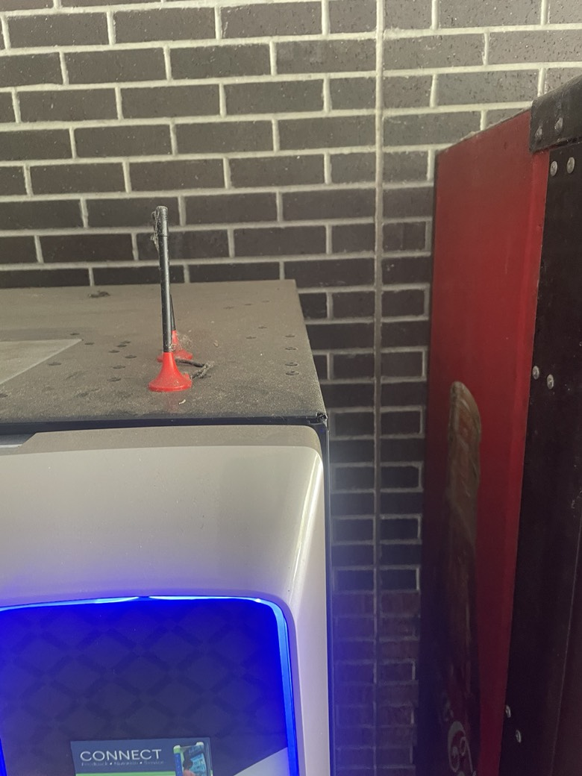
Monopole
Location: UCF College of Business
Estimated Gain and Freq:
2-3 dBi Gain @ 2.4-5 GHz
Use: This antenna is used for Knight Cash for Vending Machine, it provides WI-FI connection/

Slide 6
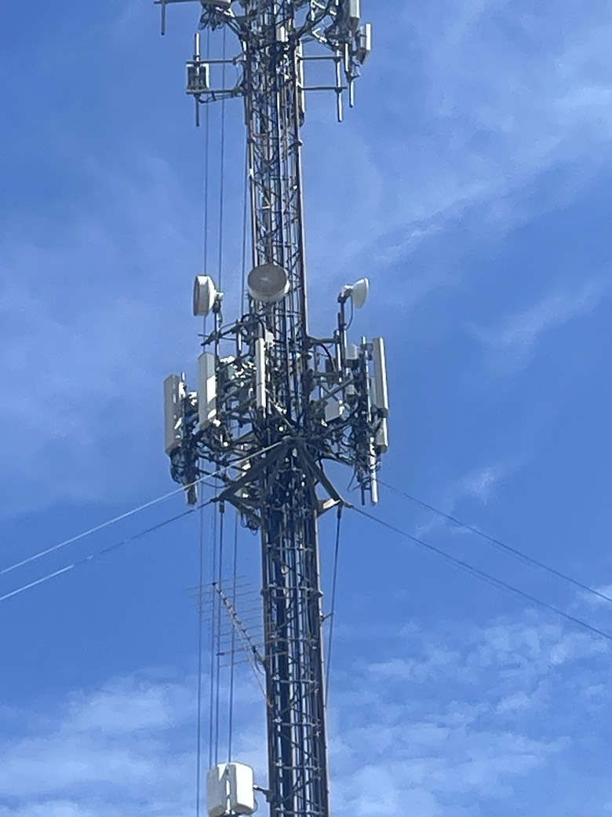
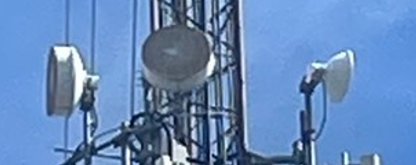
Horn Antenna with Dielectric
Location: UCF Garage C
Estimated Gain and Freq:
10-25 dBi @ 5 – 42 GHz
Use: Point to Point Communication between different cell towers.

Slide 7
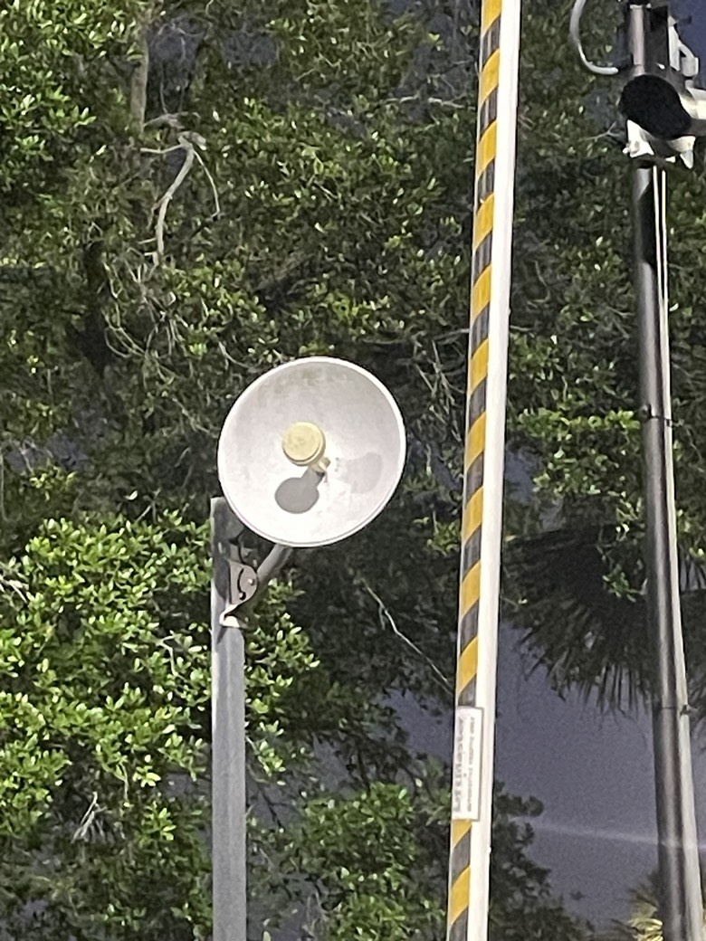
Parabolic Dish Antenna
Location: UCF Rosen Campus, Entrance Gate
Estimated Gain and Freq:
10-25 dBi @ 1-5 GHz
Use: Remote Control over Rosen Campus gate and transmit security camera video.

